Slide 1
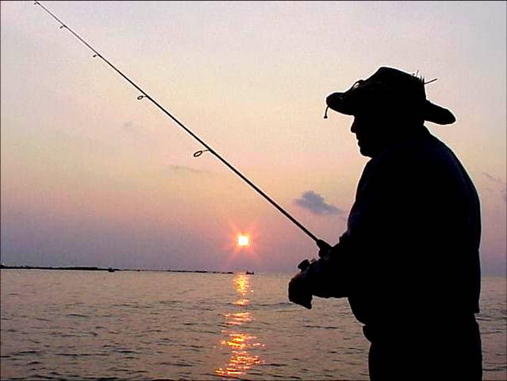
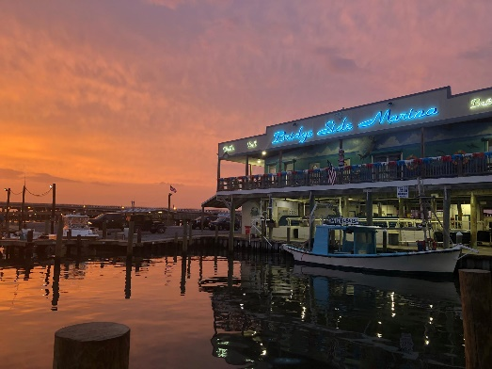
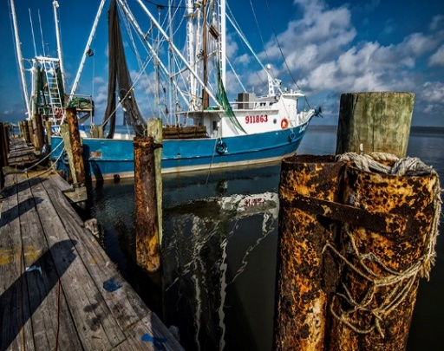
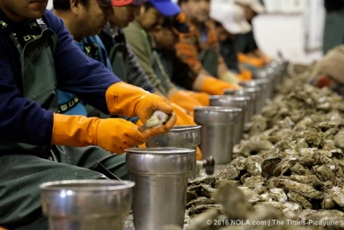
COVID-19 Impact Surveying of Louisiana Fishing Sectors (Project overview and preliminary results)
Rex H. Caffey¹, Julie Lively¹, Jack Isaacs², Kevin Savoie¹ and Jason Adriance²
¹LSU AgCenter and Louisiana Sea Grant ²Louisiana Department of Wildlife and Fisheries
Notes:
Aggregate updated 6/30

Slide 2
Objectives
1. Explain the process of COVID-19 impact survey development
2. Review preliminary results from first quarter 2020

Slide 3
Collaboration and Approach
Partnering- LDWF and LSU have developed economic impact assessments for hurricanes, floods, droughts, oil spills, trade infractions and now pandemics.
Baseline data- Collection of pre-event data for commercial sectors with a focus on seasonal effort, landings volume and value.
Surveying- Decide who to survey, how often, and what to focus on. Quarterly surveys of revenue and employment impacts were developed for 4 sectors: 1) Charter operations (marine)
2) Marinas (marine)
3) Seafood dealers/docks (marine and freshwater) 4) Seafood processors (marine and freshwater)
Notes:
Commercial fishermen were not included because of the ability of LDWF to track their activity via LDWF’s Trip Ticket system

Slide 4
Standardizing the Survey: 7 common question types
1. Descriptive questions - species handled, scale of operation, services provided, volume of product/services, number of trips, etc.
2. Business baselines - estimates of a firm’s revenue ($) and employment (#) during a typical year. A “typical year” was defined as the average level of revenue and employment for the past 5 years.
3. Revenue impacts – change in first quarter (Q1) 2020 revenue compared to Q1 revenue in a typical year.

Slide 5
Standardizing the Survey: 7 common question types
4. Employment impacts - change in first quarter (Q1) 2020 employment compared to Q1 employment in a typical year for… a) domestic full-time employees b) domestic part-time employees c) foreign, non-immigrant labor (H2A and H2B employees)
5. Attitudinal questions - concerns about worker and public exposure risk, labor availability and retention, supply and demand disruptions, etc.
6. Status questions - temporarily or permanent closure of business
7. General comments

Slide 6
Results
1. Population, sample, response rates, descriptors
2. Revenue: Baseline and 2020 Q1 impact
3. Employment: Baseline and 2020 Q1 impact

Slide 7
Charter Operations (Preliminary Results)
Survey
Population size (N): | 890
Sample size (n): | 600 (combined)
Survey methods | Web (LDWF), Web (LCBA)
Responses (Total) | 293 (49%)
Respondents | 232 complete (79%)
Descriptors
Avg. annual trips per business | 184 (Some include multiple vessels)
Inshore trips | 81%
Ownership and operations | Captain & owner of 1 vessel: 75% Captain & owner >1 vessel: 19% Captain, not owner: 4%
Notes:
Updated charter from CARES draft

Slide 8
Charter Operations: Revenue (Preliminary Results)
BASELINE REVENUE | Q1 | Q2 | Q3 | Q4 | Year (Total)
Avg. Trips (#) | 27 | 65 | 46 | 46 | 184
Typical Revenue (%) | 15% | 36% | 26% | 23% | 100
Typical Revenue ($) | $ 15,000- $ 22,500 | $ 36,000 $ 54,000 | $ 26,000- $39,000 | $ 24,000- $ 36,000 | $100,000-$150,000
2020 REVENUE | Q1 | Q2 | Q3 | Q4 | Year (Total)
Reported a reduction (%) | 95%
Avg. reported loss (%) | -61%
Est. loss per respondent ($) | $9,074 - $13,612
Aggregate reported loss ($) | $2,016,660 – $3,024,990

Slide 9
Charter Operations: Employment (Preliminary Results)
BASELINE EMPLOYMENT | Q1 | Q2 | Q3 | Q4 | Year (Avg)
Full Time workers (#) | 1.8 | 2.2 | 2.0 | 1.9 | 2.0
Part Time workers (#) | 0.9 | 1.6 | 1.3 | 1.1 | 1.2
2020 EMPLOYMENT | Q1 | Q2 | Q3 | Q4 | Year (Avg)
Reporting a reduction (%) | 55%
Full-time workers (%) | -36%
Part-time workers (%) | -32%
Temporary Closures (%) | 46%
Comments | Have not receive government aid, travel restrictions have stopped clients, will last longer than Q1, seeing cancellations all year

Slide 10
Marina Operations (Preliminary Results)
Survey
Population size (N): | 62
Sample size (n): | 62
Survey methods | Phone, Web
Responses (Total) | 26 (42%)
Responses (Complete) | 15 complete (58%)
Descriptors
Business services (%) | Boat launch, restrooms, food, tackle, ice (87%) Boat docks (81%) Fuel (69%) Frozen bait & Lodging (63%) Live bait & Wet slip rental (56%) Restaurant (44%) Charter services & Fish cleaning (38%)
Notes:
-Coastal zone marinas based off of LA Creel and then SG agent local knowledge.
-Top 10 business services

Slide 11
Marina Operations: Revenue (Preliminary Results)
BASELINE REVENUE | Q1 | Q2 | Q3 | Q4 | Year (Total)
Typical Revenue (%) | 11% | 29% | 36% | 24% | 100
Typical Revenue ($) | $82,000- $110,000 | $217,000-$290,000 | $270,000- $360,000 | $180,000- $240,000 | $750,000-$1,000,000
2020 REVENUE | Q1 | Q2 | Q3 | Q4 | Year (Total)
Reported a reduction (%) | 73%
Avg. reported loss (%) | -68%
Est. loss per respondent ($) | $56,100-$74,800
Aggregate reported loss ($) | $614,295 $819,060
Notes:
-Of those 73% that reported a loss, the average loss was 68% which would be 56-74 in Q1. Aggregate of the respondents would be a total of $1 to under $1.5

Slide 12
Marina Operations: Employment (Preliminary Results)
BASELINE EMPLOYMENT | Q1 | Q2 | Q3 | Q4 | Year (Avg)
Full Time workers (#) | 5.4 | 8.7 | 8.4 | 6.3 | 7.2
Part Time workers (#) | 3.4 | 3.9 | 4.6 | 3.4 | 3.6
2020 EMPLOYMENT | Q1 | Q2 | Q3 | Q4 | Year (Avg)
Reporting a reduction (%) | 50% | April-June | July-Sep | Oct-Dec | Jan-Dec
Full-time workers (%) | -17%
Part-time workers (%) | -4%
Temporary Closures (%) | 64%
Comments | 2019 Freshwater disaster still a problem, delayed opening for seasonality not counted in closures, hurricane impact concerns
Notes:
-Employment based on workers, not hours.
-17% individuals
-4% individuals
64% closed temporarily, predominately in the 3rd week of March

Slide 13
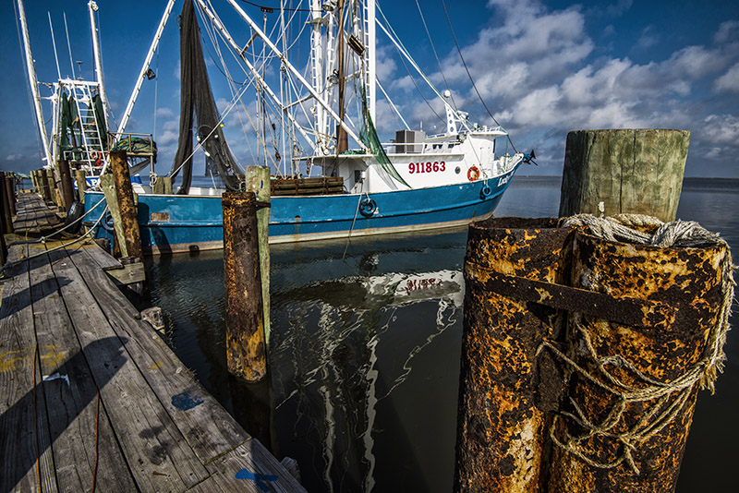
Seafood Docks/Dealers (Preliminary Results)
Survey
Population size (N): | 1515
Sample size (n): | 181
Survey methods | Phone, Web
Responses (Total) | 72 (40%)
Responses (Complete) | 46 complete (63%)
Descriptors
Percent of seafood purchased annually | Blue crab (35%) Shrimp (28%) Crawfish (16%) Oyster (12%) Fish: Marine & Fresh (9%)
Notes:
-1515 is total LA docks and dealers (fresh and marine)
-181 is from the sample pulled by the department with 85% representing over 100,000 lbs. The goal was to capture the majority of the seafood

Slide 14
Seafood Docks/Dealers: Revenue (Preliminary Results)
BASELINE REVENUE | Q1 | Q2 | Q3 | Q4 | Year (Total)
Typical Revenue (%) | 18% | 40% | 25% | 17% | 100
Typical Revenue ($) | $180,000- $900,000 | $400,000-$2,000,000 | $250,000- $1,250,000 | $170,000- $850,000 | $1,000,000-$5,000,000
2020 REVENUE | Q1 | Q2 | Q3 | Q4 | Year (Total)
Reported a reduction (%) | 93%
Avg. reported loss (%) | -51%
Est. loss per respondent ($) | $91,800-$459,000
Aggregate reported loss ($) | $3,927,204- $19,636,020
Notes:
Of the 93%, the average loss was 51%

Slide 15
Seafood Docks/Dealers: Employment (Preliminary Results)
BASELINE EMPLOYMENT | Q1 | Q2 | Q3 | Q4 | Year (Avg)
Full Time workers (#) | 4.2 | 5.4 | 5.6 | 4.9 | 5.0
Part Time workers (#) | 0.8 | 1.1 | 1.3 | 0.9 | 1.0
Foreign workers (#) | 0.6 | 2.8 | 2.8 | 2.8 | 2.2
2020 EMPLOYMENT | Q1 | Q2 | Q3 | Q4 | Year (Avg)
Reporting a reduction (%) | 49%
Full Time workers (#) | -55%
Part Time workers (#) | +67%
Foreign workers (#) | -100%
Temporary Closures (%) | 33%
Comments | 2019 Floods, Lax enforcement of co. origin label. during pandemic, Closed portions of business not reflected in percent closure estimates
Notes:
Again, this is individuals, and this time includes Foreign workers or primarily h2A/ H2B
-49% reported a reduction in workforce, and of those it was 55% loss for full time, a gain of 67% part time as businesses told us reduced many full time to PT and the hours of PT. and 100% loff of foreign workers.
-33% had a temporary closure

Slide 16
Seafood Processors (Preliminary Results)
Survey
Population size (N): | 366
Sample size (n): | 285
Survey methods | Phone, Web
Responses (Total) | 89 (31%)
Responses (Complete) | 69 complete (78%)
Descriptors
Percent of seafood processed annually | Crawfish (26%) Shrimp (21%) Blue crab (13%) Oyster (19%) Fish: Marine & Fresh (14%) Alligator (6%) Frogs (>1%)
Notes:
The 366 is from LDH’s processor list. This is any business holding a processing permit. However, many were not active, so our n was 285. Unlike dealers and docks, this group could not be filtered by size or species.

Slide 17
Seafood Processors: Revenue (Preliminary Results)
BASELINE REVENUE | Q1 | Q2 | Q3 | Q4 | Year (Total)
Typical Revenue (%) | 22% | 31% | 26% | 11% | 100
Typical Revenue ($) | $220,000 – 1,100,000 | $310,000-$1,550,000 | $260,000- $1.300,000 | $210,000-$1,050,000 | $1,000,000-$5,000,000
2020 REVENUE | Q1 | Q2 | Q3 | Q4 | Year (Total)
Reported a reduction (%) | 80%
Avg. reported loss (%) | -58%
Est. loss per respondent ($) | $127,600-$638,000
Aggregate reported loss ($) | $6,723,360 – $33,616,800
Notes:
-80% reduction and of those 80%, the average loss was 58%

Slide 18
Seafood Processors: Employment (Preliminary Results)
BASELINE EMPLOYMENT | Q1 | Q2 | Q3 | Q4 | Year (Avg)
Full Time workers (#) | 12.2 | 12.7 | 10.7 | 10.2 | 11.5
Part Time workers (#) | 3.4 | 4.5 | 3.2 | 2.5 | 3.4
Foreign workers (#) | 8.7 | 8.7 | 5.5 | 4.8 | 6.9
2020 EMPLOYMENT | Q1 | Q2 | Q3 | Q4 | Year (Avg)
Reporting a reduction (%) | 51%
Full Time workers (#) | -25%
Part Time workers (#) | -29%
Foreign workers (#) | -100%
Temporary Closures (%) | 30%
Comments | 2019 Floods, COO labeling enforcement, Lack of H2B workers, Stockpiling domestic and import product will flood market
Notes:
-

Slide 19
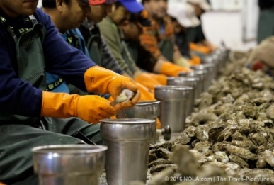
Concerns and Expectations
 | CHARTER | MARINAS | DOCKS/DEALERS | PROCESSORS
Primary concerns | 1. Reduced demand (98%) 2. Return of workers (72%) 3. Exposure of clients (68%) | Exposure of workers (50%) 2. Availability of supplies (50%) | 1. Reduced demand (77%) 2. Exposure of workers (65%) 3. Default on invoices (60%) | 1. Reduced demand (80%) 2. Exposure of workers (78%) 3. Default on invoices (72%)
Second Quarter (Q2) Expectations | Worse 59% Better 19% | Worse 28% Better 65% | Worse 32% Better 48% | Worse 46% Better 22%

Slide 20
Next Steps
Majority of respondents have agreed to participate in follow-up quarterly surveys
Subsequent surveys (Q2, Q3, and Q4) to be implemented throughout remainder of 2020
Comparison of survey-reported impacts with other data sources (e.g. 3-day trip-license sales and LA CREEL for charters, trip tickets for dealers)
Interim reports produced as needed to help track impacts and assist with procurement of recovery funds

Slide 21
Special thanks to Lauren Carter, Allen Schaefer, and Elizabeth Robinson
DRAFT July 10, 2020

